Slide 1

Mini Project Review-1
Batch No: AA12
Project Title: Short-term Load Forecasting Method of Smart Grid using DNN and LSTM
S.NoE | Regd.No | Student Name
1 | 22A81A6130 | K.Jithendra
2 | 22A81A6126 | K.V.V.S Vinay
3 | 22A81A6145 | N.Raja
4 | 23A85A6102 | E.Tirupati Rao
Project Guide:
Mr.V.Rama Narayana M.Tech(Ph.D)

Slide 2
Abstract:
In the rapidly evolving landscape of smart grids, accurate short-term load forecasting is essential for optimizing energy distribution and maintaining grid stability. This project presents a hybrid forecasting method that leverages the strengths of Deep Neural Networks (DNN) and Long Short-Term Memory (LSTM) neural networks to improve prediction accuracy for short-term load forecasting. The proposed method integrates the powerful feature learning capabilities of DNNs with the sequence modeling strength of LSTM networks, effectively capturing both non-linear relationships and temporal dependencies in load data.
The forecasting model begins with data preprocessing, including normalization and decomposition, to enhance the quality of input features. The DNN component is employed to extract complex patterns and interactions from the input features, while the LSTM network is specifically designed to handle time series data, capturing long-term dependencies and trends in the load demand. The hybrid approach allows the model to learn both static and dynamic aspects of the data, leading to a more robust and accurate forecasting solution

Slide 3
Literature Survey:
Lee, D.
Contribution: Developed a method for short-term wind power forecasting.
Approach: Combined Gaussian processes with neural networks in an ensemble model.
Outcome: Improved the accuracy of wind power predictions, which enhances reliability
for energy management and grid integration.
Kosek, A. M.
Contribution: Proposed a model for anomaly detection in smart grids to identify cyber-physical
intrusions.
Approach: Used an ensemble regression model to detect unusual patterns that may indicate potential
attacks or intrusions.
Outcome: Enhanced the security and reliability of smart grids through improved intrusion detection
capabilities.
Abuella, M.
Contribution: Developed a hybrid model for solar power forecasting.
Approach: Combined Random Forest with Support Vector Regression (SVR) in an ensemble framework.
Outcome: Improved prediction accuracy by utilizing the strengths of both Random Forest and SVR, providing a robust
solution for solar energy management.

Slide 4
Problems in Existing System:
Inadequate Feature Learning: Traditional models like Multiple Linear Regression (MLR) struggle to capture complex, non-linear relationships in load data, leading to reduced accuracy
Poor Temporal Dependency Modeling: Existing methods often fail to effectively capture the temporal dependencies and long-term trends inherent in time series data, resulting in less accurate predictions.
Limited Model Robustness: Standalone neural networks may not fully leverage the static and dynamic aspects of the data, leading to suboptimal forecasting performance.
Lack of Integration Between Methods: Many models do not combine the strengths of different neural network architectures, limiting their ability to address the complexities of short-term load forecasting in smart grids.
Suboptimal Performance on Real-World Data: Traditional forecasting models often underperform when applied to real-world smart grid data, lacking the ability to generalize effectively across varying conditions and data sets.

Slide 5
Proposed System:
Hybrid Approach: The system integrates DNN and LSTM to leverage their respective strengths—DNNs for extracting complex patterns from the data and LSTMs for capturing temporal dependencies and trends.
Enhanced Data Preprocessing: The system begins with advanced data preprocessing techniques, including normalization and decomposition, to improve the quality of input features and ensure more accurate predictions.
Dual Focus on Static and Dynamic Data: By combining DNN and LSTM, the system can effectively learn both static and dynamic aspects of the load data, leading to more robust and precise forecasts.
Improved Prediction Accuracy: The hybrid model outperforms traditional forecasting methods and standalone neural networks in terms of accuracy, making it a more reliable tool for smart grid management.
Scalability and Efficiency: The proposed method is designed to be computationally efficient, making it suitable for both medium and large datasets, and scalable to different smart grid environments

Slide 6

Objectives:
Improve Forecasting Accuracy: To develop a method that significantly enhances the prediction accuracy of short-term load forecasts by leveraging the strengths of both DNN and LSTM networks.
Capture Complex Patterns and Dependencies: To effectively model both non-linear relationships and temporal dependencies within load data, ensuring a comprehensive understanding of the underlying patterns.
Enhance Data Processing: To implement advanced data preprocessing techniques, such as normalization and decomposition, that improve the quality of input features and contribute to more reliable forecasts.
Optimize Computational Efficiency: To create a forecasting system that is computationally efficient, allowing for real-time application and scalability across different sizes of datasets in smart grid environments.

Slide 7
Project Domain:
Domain: Smart Grid Technology, Machine Learning, and Data Analytics
Focus: Short-Term Load Forecasting (STLF) using hybrid machine learning models (DNN and LSTM) to optimize energy distribution and grid stability.

Slide 8
Requirement Analysis:
Functional Requirements:
Data Ingestion and Preprocessing
Sequence Modeling
Feature Extraction
Hybrid Model Integration
Forecasting Output
Performance Evaluation
Non-functional Requirements
Scalability
Reliability
Performance
Usability
Security
Maintainability

Slide 9
Requirement Analysis:
Software Requirements:
Operating System: Windows, Linux, or macOS
Programming Languages:
1)python
2)sql
Machine Learning Libraries: TensorFlow, Keras, Scikit-learn
Version Control: Git and GitHub/Bitbucket for version control and collaboration
IDE/Development Tools: PyCharm, Jupyter Notebook, or Visual Studio Code
Processor: Multi-core processor (Intel i5 or higher, or equivalent AMD Ryzen)
RAM: Minimum 16 GB (32 GB recommended for large datasets)
Storage: SSD with at least 500 GB of free space
Network: High-speed internet connection for data transfer and access to cloud-based resources

Slide 10
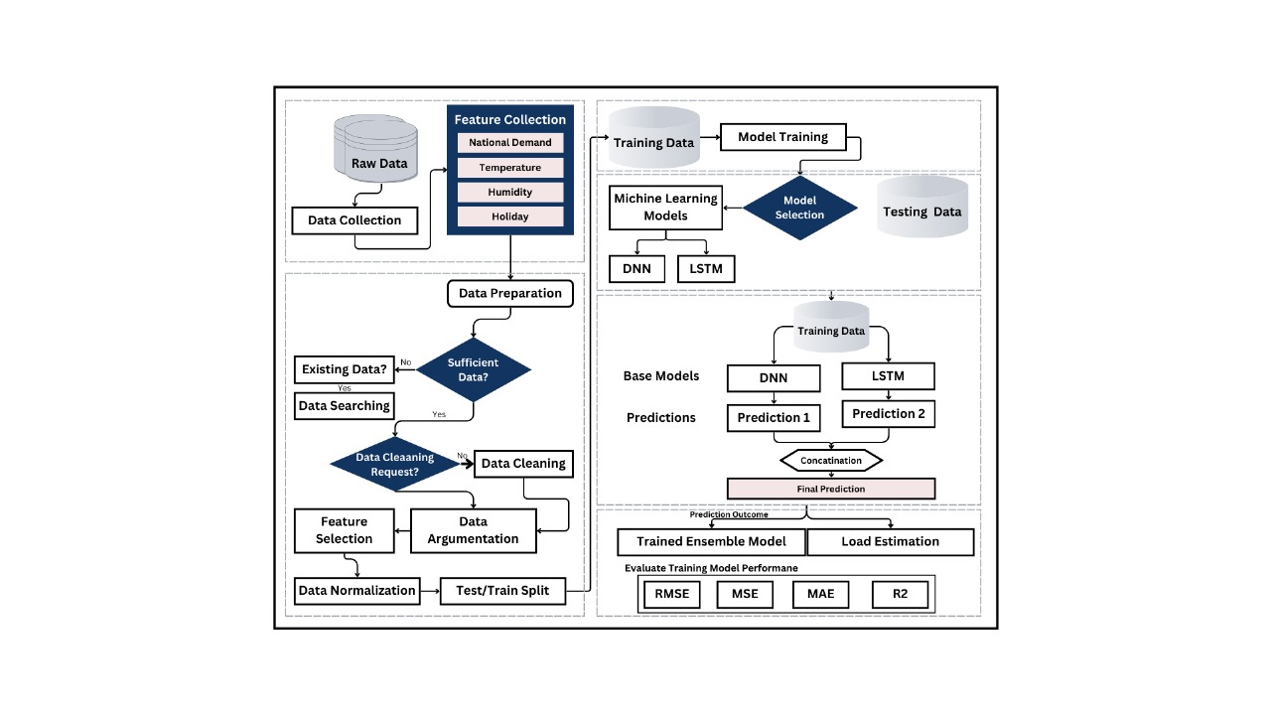
System Architecture
Data Collection: Gather raw data (e.g., demand, temperature, humidity, holiday info).
Data Preparation: Check for data availability and quality, clean as needed, select features, augment, normalize, and split into training/testing sets.
Model Training: Train DNN and LSTM models on training data.
Ensemble Prediction: Combine predictions from DNN and LSTM models for a final result.
Evaluation: Assess model performance using metrics like RMSE, MSE, MAE, and R².

Slide 11
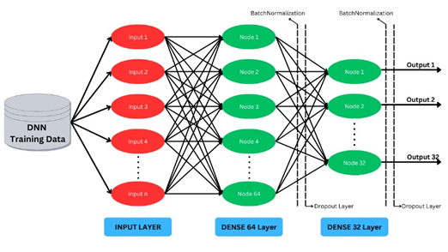
DNN ALGORITHM:
Input Layer: Accepts multiple input features (e.g., Input 1, Input 2, etc.).
Dense Layers:
Dense 64 Layer: Contains 64 nodes, with batch normalization applied for stability and faster convergence.
Dense 32 Layer: Contains 32 nodes, also using batch normalization and a dropout layer to prevent overfitting.
Output Layer: Produces multiple outputs, which could represent different classes or regression targets.

Slide 12
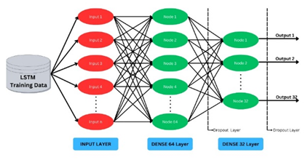
LSTM ALGARITHM:
Input Layer: Receives multiple inputs (e.g., Input 1, Input 2, etc.) for LSTM training data.
Dense Layers:
Dense 64 Layer: Contains 64 nodes to process input data.
Dense 32 Layer: Contains 32 nodes, with a dropout layer to reduce overfitting.
Output Layer: Produces several outputs, which could correspond to various predictions or classifications.

Slide 13
Methodology:
Data Collection and Preprocessing
Data Collection: Collect historical load data, weather conditions, and other relevant datasets from smart grid sensors and external sources.
Data Preprocessing:
Normalization: Scale the data to a consistent range to improve model performance.
Decomposition: Break down the data into trend, seasonality, and residual components to enhance feature extraction.
Handling Missing Data: Implement techniques such as imputation or interpolation to address gaps in the dataset.
Feature Extraction Using DNN
Design DNN Architecture: Develop a Deep Neural Network with multiple layers to capture complex patterns and interactions in the data.
Temporal Modeling Using LSTM
Design LSTM Architecture: Develop a Long Short-Term Memory network to model temporal dependencies and long-term trends in the time series data.

Slide 14
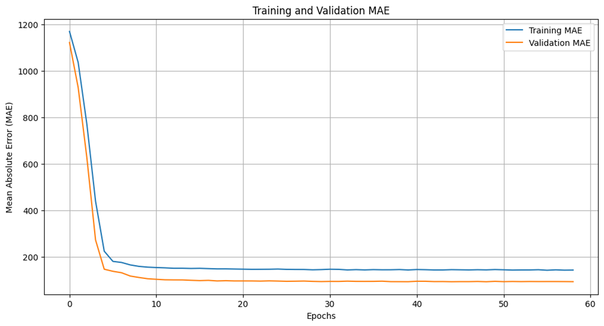
OUTPUT

Slide 15
Result Analysis:
For the combined DNN + LSTM model, training accuracy increased rapidly in the initial epochs, reaching near-perfect accuracy by the 20th epoch. Validation accuracy, however, plateaued much earlier and remained steady throughout training. This indicates that the DNN + LSTM model achieved its peak generalization performance within the first few epochs, similar to the DNN model, but with a closer alignment between training and validation accuracy.
The smaller gap between training and validation accuracy in the DNN + LSTM model suggests a more balanced fit compared to the individual DNN and LSTM models, though slight overfitting is still present.

Slide 16
TEAM(AA12)

